Slide 1
Finger Pointing as a Rapid and Natural Trigger for Device Selection and Interaction
David Tung
7/31/2024

Slide 2
Advisor Feedback Status
Advisor Feedback Status
1. Delete “when needed” from the issue statement. · For the next time please clearly state the novelty of the research. Please develop a slide that clearly shows what are existing models and how they are being changed or what new models are being developed.
>> Slide was updated according to the feedback.
2. <Advisor feedback>
<How it was resolved>
3. <Advisor feedback>
<How it was resolved>
4. <Advisor feedback>
<How it was resolved>

Slide 3
Glossary of Terms
Term | Definition
Assistive technology | Mobility devices such as walkers and wheelchairs, as well as hardware, software, and peripherals that assist people with disabilities in accessing computers or other information technologies
Point cloud | In 3D modeling, a point cloud is a set of data points in a 3D coordinate system—commonly known as the XYZ axes. Each point represents a single spatial measurement on the object's surface. Taken together, a point cloud represents the entire external surface of an object.
3D Bounding Box | A 3D box region within an image that contains an object is defined by its minimum and maximum x, y, and z coordinates. Alternatively, it can be described by its center point coordinates (x, y, z), along with its width, height, and depth (w, h, d). Each of these regions is also associated with a class label identifying the type of object it contains.
Zero-shot learning (ZSL) | A machine learning scenario in which an AI model is trained to recognize and categorize objects or concepts without having seen any examples of those categories or concepts beforehand

Slide 4
Acronyms
Acronym | Definition
CNN | Convolutional Neural Network
ML | Machine Learning
CVPR | Computer Vision and Pattern recognition Conference
ICCV | International Conference on Computer Vision
ADA | Americans with Disabilities Act
AHS | American Housing Survey
DP | Deep Learning
DLT | Direct Linear Transformation
CF | Confusion Matrix

Slide 5
Problem Statement
(A) Deliverable | (B) Format | (C) WC
Issue | Individuals using wheelchairs encounter difficulties attempting to access electrical switches/buttons | 10
Reference | Smart Cities Dive. (2020, July 24). The ADA is turning 30, but the built environment is still far from inclusive. Smart Cities Dive. https://www.smartcitiesdive.com/news/the-ada-is-turning-30-but-the-built-environment-is-still-far-from-inclusiv/581563/ | NA
”so what” | 35% of U.S. households are not equipped for independent wheelchair living, potentially some of them require modifications when needed. | 19
Reference | U.S. Department of Housing and Urban Development. (n.d.). Accessibility of America’s Housing Stock: Analysis of the 2011 American Housing Survey (AHS). HUD USER. https://www.huduser.gov/portal/sites/default/files/pdf/accessibility-america-housingStock.pdf | NA
Problem Statement | Individuals using wheelchairs encounter difficulties attempting to access electrical switches/buttons, as 35% of U.S. households are not equipped for independent wheelchair living, potentially some of them require modifications. | 30
Industry | Assistive technology | NA
PS Elaboration 1 | Even the places that comply with the Americans with Disabilities Act (ADA), individuals using wheelchairs are often required to extend their reach to the operating buttons/switches. | 27
PS Elaboration 2 | Assistive devices, such as canes, robotic arms, intelligent eyewear, mobile phones, or AI-enabled wearables, come with a high cost. | 19

Slide 6
Thesis Statement
(A) Deliverable | (B) Format | C) WC
Thesis Statement | Machine learning models are required to accurately interpret a person's intention to engage with a device/switch/button by recognizing pointing gestures. | 25
Research Product | Classification model
Format | Python
Deliverable Usage | Integrators who can use this technology when they try to provide low-cost touchless device control solutions for wheelchair users Integrators can use this technology when they try to provide low-cost touchless device control solutions for wheelchair users. | 19
PS Tie Back | Individuals using wheelchairs encounter difficulties attempting to access electrical switches can leverage finger-pointing recognition based on video/image from the camera to select and then control devices | 23
New contributions | Provide a cost-effective and touch-free control of devices for wheelchair users to use finger-pointing gestures to control devices enabled by AI/computer vision. | 22
Scope | This idea can be adopted by any industry in which individuals wish to operate devices without physical contact. | 17
Methodology | Machine Learning (transformer, deep learning), Computer vision
Inputs | Videos and images featuring pointing gestures and pointed objects from the camera | NA
Outputs | Pointed object classes/labels with probability | NA

Slide 7
Research Question Instructions
Deliver a table in below format. Keep column A as is. Fill columns B & C. Do not include column D.
(A) Deliverable | (B) Format | C) WC
Research Question 1 | How effectively can the proposed AI model predict finger-pointing direction based on images of persons in a sitting position? | 19
Research Question 2 | How accurately can the proposed AI model, associated with 3D point cloud localization, classify the object at which a person is pointing? | 21
Research Question 3 | Can an alternative 3D bounding box localization outperform the proposed 3D point cloud in classifying the object that a person is pointing at? | 26

Slide 8
Research Question Instructions
(A) Deliverable | (B) Format | C) WC
Hypothesis 1 | A finger-pointing direction prediction model trained with images of seated positions is expected to outperform the direction prediction performance using full dataset. | 28
Independent Variables | Images, videos, metadata | NA
Dependent Variable | 3D Direction vector and probability | NA
Testable | Split the dataset to include only images of individuals in seated positions. Subsequently, evaluate and compare the precision and recall metrics of this approach with those reported in the referenced paper which is trained with full dataset. | 45
Hypothesis 2 | An AI model integrated with 3D point cloud object classification method can accurately (>=70%) detect and classify object that is pointed at by a wheelchair user. | 27
Independent Variables | Images, videos, metadata | NA
Dependent Variable | Pointed object label and probability | NA
Testable | Utilize the test outcomes from Hypothesis 1 to predict the object class and compute the object intersections using 3D point cloud methodologies. Subsequently, calculate the accuracy for comparison. | 43
Hypothesis 3 | An AI model integrated with 3D point cloud intersection (from Hypothesis 2) can outperform bounding box object intersection algorithms in detecting and classifying the object pointed at by a wheelchair user. | 21
Independent Variables | Images, videos, metadata | NA
Dependent Variable | Pointed object label and probability | NA
Testable | Utilize the test outcomes from Hypothesis 1 to to predict the object class and compute the object intersections using bounding box methodologies. Subsequently, compare these findings with the results from Hypothesis 2. | 26

Slide 9
Annotated Bibliography
(A) Deliverable | (B) Format | (C) WC
Reference | Nakamura, S., Kawanishi, Y., Nobuhara, S., & Nishino, K. (2023). DeePoint: Visual Pointing Recognition and Direction Estimation. In Proceedings of the IEEE/CVF International Conference on Computer Vision (pp. 20577-20587). | NA
Summary | First-of-its-kind large-scale dataset for pointing recognition and direction estimation consists of 2M frames, 33 people pointing in various styles annotated for each frame with pointing timings and 3D directions. DeePoint is a Transformer-based model that utilizes the spatial and temporal alignment of body parts, beyond just the hands, for combined recognition and 3D directional estimation of pointing gestures. | 58
Methodology | Machine Learning, Transformer, Deep Learning | NA
Evaluation | Paper accepted by the 2023 ICCV conference Git: https://github.com/kyotovision-public/deepoint Data: https://drive.google.com/drive/folders/1W_49HId_2FLFH0X9Ry8QiTTyaVt2Y0ks Limitation: There are not selected objects predicted (their to-do list) | 16
Relevance | Highly matches my goal to provide the prediction of finger-pointing 3D vector This paper provides both a dataset and model for me to start my praxis | 26

Slide 10
Annotated Bibliography
(A) Deliverable | (B) Format | (C) WC
Reference | Kim, D., Mollyn, V., & Harrison, C. (2023). WorldPoint: Finger Pointing as a Rapid and Natural Trigger for In-the-Wild Mobile Interactions. Proceedings of the ACM on Human-Computer Interaction, 7(ISS), 357-375. | NA
Summary | Use the recent inclusion of wide-angle, rear-facing smartphone cameras, along with hardware-accelerated machine learning, to enable real-time, infrastructure free, finger-pointing interactions on today’s mobile phones. | 25
Methodology | Machine Learning, Deep Learning, CNN, point cloud | NA
Evaluation | Paper from CMU researchers in 2023 Limitation: require mobile phone | 10
Relevance | Highly relevant in finger-pointed object detection except it is mobile phone-based and there is no device control. | 18

Slide 11
Annotated Bibliography
(A) Deliverable | (B) Format | (C) WC
Reference | Liu, C., Hu, Y., Li, Y., Song, S., & Liu, J. (2017). Pku-mmd: A large scale benchmark for continuous multi-modal human action understanding. arXiv preprint arXiv:1703.07475. | NA
Summary | PKU-MMD is a new large scale benchmark for continuous multi-modality 3D human action understanding and covers a wide range of complex human activities with well annotated information. PKU-MMD contains 2 phases, for action detection tasks with increasing difficulty. Phase 1 is large-margin action detection task. Phase 2 is small-margin action detection task. Our dataset also provides multi-modality data sources, including RGB, depth, Infrared Radiation and Skeleton. We believe this large-scale dataset will benefit future researches on action detection for the community.
Methodology | Machine Learning, Deep Learning, CNN | NA
Evaluation | Paper from PKU researchers in 2017, which is a Large Scale Benchmark for Continuous Multi-Modal Human Action Understanding Limitation: require mobile phone | 19
Relevance | Cross validation | 18

Slide 12
Annotated Bibliography
(A) Deliverable | (B) Format | (C) WC
Reference | Mousavian, A., Anguelov, D., Flynn, J., & Kosecka, J. (2017). 3d bounding box estimation using deep learning and geometry. In Proceedings of the IEEE conference on Computer Vision and Pattern Recognition (pp. 7074-7082). | NA
Summary | Recover the 3D bounding boxes for known object categories from a single view. Using a novel MultiBin loss for orientation prediction and an effective choice of box dimensions as regression parameters. This method estimates stable and accurate posed 3D bounding boxes without additional 3D shape models, or sampling strategies with complex pre-processing pipelines.
Methodology | Machine Learning, Deep Learning | NA
Evaluation | Paper accepted by the 2017 CVPR conference Git: https://github.com/skhadem/3D-BoundingBox Limitation: | 10
Relevance | Highly relevant in object detection and 3D bounding box | 9

Slide 13
Annotated Bibliography
(A) Deliverable | (B) Format | (C) WC
Reference | Yang, L., Kang, B., Huang, Z., Xu, X., Feng, J., & Zhao, H. (2024). Depth anything: Unleashing the power of large-scale unlabeled data. In Proceedings of the IEEE/CVF Conference on Computer Vision and Pattern Recognition (pp. 10371-10381). | NA
Summary | Depth Anything is trained on 1.5M labeled images and 62M+ unlabeled images jointly, providing the most capable Monocular Depth Estimation (MDE) foundation models with the following features: zero-shot relative depth estimation, better than MiDaS v3.1 (BEiT_{L-512}) zero-shot metric depth estimation, better than ZoeDepth optimal in-domain fine-tuning and evaluation on NYUv2 and KITTI
Methodology | Machine Learning, Deep Learning | NA
Evaluation | Paper accepted by the 2024 CVPR conference https://github.com/LiheYoung/Depth-Anything | 10
Relevance | Highly relevant in depth estimation | 5

Slide 14
Annotated Bibliography
(A) Deliverable | (B) Format | (C) WC
Reference | Zhang, C., Ling, Y., Lu, M., Qin, M., & Wang, H. (2024). Category-level Object Detection, Pose Estimation and Reconstruction from Stereo Images. arXiv preprint arXiv:2407.06984. | NA
Summary | This paper presents CODERS, a one-stage approach for Category-level Object Detection, pose Estimation, and Reconstruction from Stereo images. The base of our pipeline is an Implicit Stereo Matching module that combines stereo image features with 3D position information.
Methodology | Machine Learning, Deep Learning | NA
Evaluation | Paper accepted by the 2024 ECCV conference https://xingyoujun.github.io/coders/?fbclid=IwZXh0bgNhZW0CMTAAAR0IGuyn2xHbrdY8_1iNNBVrR8IMKn_H4LafpzmT2gGTYp5Lps7dW2Al0aQ_aem_-NUraQYijssC2jZ3SSFvBQ#todo | 10
Relevance | Highly relevant in 3D object bounding box estimation | 8

Slide 15
Data Sources List
For each data source in your praxis, complete a row in the below template.
ID | Name | Source | Brief Description | Format | Time Span | Num. of records | Access (Y/N)
1 | Deepoint (DP) dataset | https://drive.google.com/drive/folders/1W_49HId_2FLFH0X9Ry8QiTTyaVt2Y0ks | First-of-its-kind largescale dataset for pointing recognition and 3D direction estimation. License: CC BY-NC 4.0 ICCV 2023 | Jpeg, json, yaml, pickle | 2023 | 2.8 M frames | Y
2 | PKU-MMD dataset | https://github.com/ECHO960/PKU-MMD | PKU Multi-Modality Dataset) is a large-scale benchmark for continuous multi-modal 3D human action understanding. It covers a wide range of complex human activities with well-annotated information. For cross validation License: Apache 2.0 | Jpeg, png, avi, label | 2017 | 5.4 M frames | Y
3 | .. | .. | .. | .. | .. | .. | ..

Slide 16
Data Source Example
For each of data sources listed in your Data Sources List slide, complete a Data Source Example slide.
ID | Name | Source | Brief Description | Format | Time Span | Num. of records | Access (Y/N)
1 | DP dataset | 2023-01-17-livingroom/take1/00/ | Images for pointing recognition and 3D direction estimation in living room | JPG | 2023 | 100 | Y
Purpose: The image will be utilized for body pose estimation and the pose estimation will be used as input to the encoder for training purposes to predict the pointing direction.
Data treatment: The primary process will involve filtering out non-sitting positions using pose estimation.
Sample data: (next slide)

Slide 17
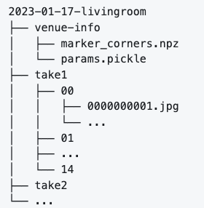
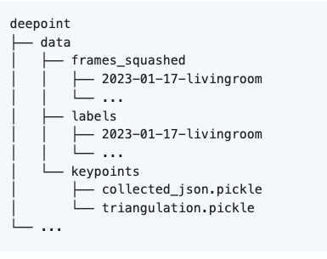
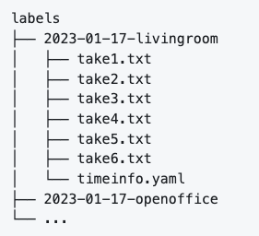


Sample data

Slide 18
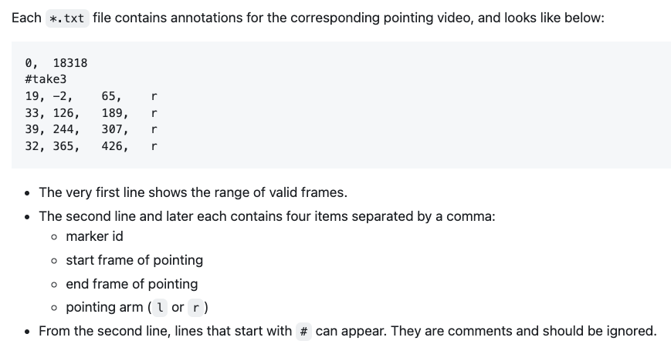
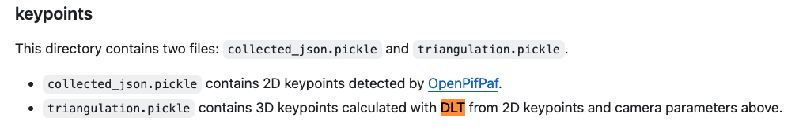
Sample data (cont)

Slide 19
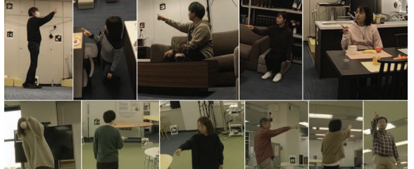

Slide 20
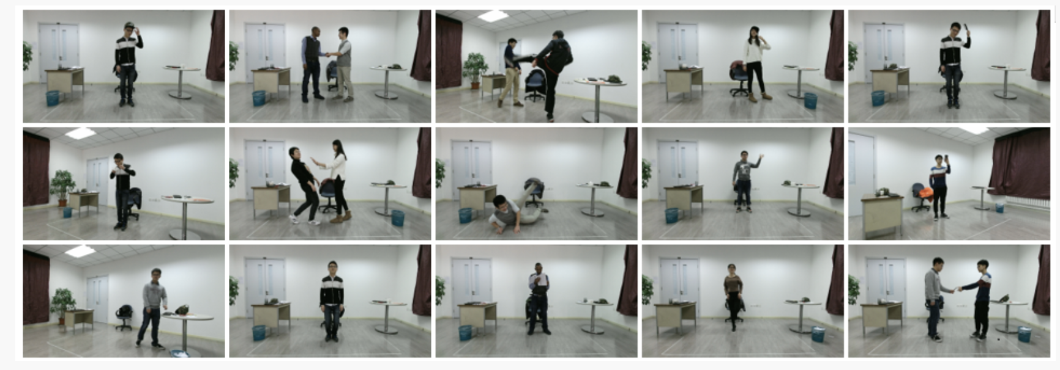
PKU-MMD

Slide 21
Block Diagram of Pointing Objects Classification – Level 1
1. Collect Image Data
Gather datasets required for model training
Tools: Python, AWS S3, SageMaker, EC2 required
2. Pre-Process Data
Filter data to include persons in sitting positions only.
Separate data into training, test, and validation sets.
Tools: Python, SageMaker, S3, Spark, EC2
3. Build and train the custom DeePoint Model
Train model with pre-processed training dataset
Tools: Python, SageMaker, PyTorch
4. Eval the Model and compare with baseline performance
Eval model with eval dataset
Compare performance number ( precision, recall)
Tools: Python, pytorch
5. Setup point-cloud objects pre-train model
Prepare 3D point cloud object model
Tools: Python, Pytorch, Sagemaker
6. Build 3D object classification and intersection algorithm based on point-cloud
Prepare a geometry calculation module to calculate the intersection
Tools: Python, Numpy
7. Eval pointing object classification with the object point cloud and collect results
Run pipeline with test dataset
Document performance ( precision, recall)
Tools: Python, Pytorch, CF matrix
8. Setup 3D objects bounding box pre-train models
Prepare bonding box for object intersection calculation
Tools: Python.
10. . Eval pointing object classification with bounding box and compare results
Test pipeline with the test dataset
Document performance ( precision, recall)
Tools: Python, Pytorch, CF matrix
11. Final conclusion
Discuss results of experimentation
Discuss models and code structure
Discuss tools used or explored
9. Build 3D object classification and intersection algorithm based on bounding box
Prepare a geometry calculation module to calculate the intersection
Tools: Python, NumPy

Slide 22
Methodology Steps – Box 1 – Second Level
1.1 Setup cloud infra: AWS EC2 and S3 storage for data
Create AWS account
Create EC2 instance and S3 storage
Create SageMaker domain
Make sure the EC2 instance is remotely accessible (SSH)
1. Collect Image Data
Gather datasets required for model training and attribution
Tools: Python, AWS S3, SageMaker, EC2 required
1.2 Download Data
Copy Deepoint dataset from Google Drive to AWS S3 storage
Copy PKU-MMD dataset to S3
1.3 Mount Data
Make data available to EC2 for later use
Mount Deepoint data as a squash file system on EC2 instance
1.4 Analyze and verify data
Data analysis using SageMaker notebook and Python
Verify downloaded data (size, checksum…)
Document stats (mean, ave, std…)

Slide 23
Methodology Steps – Box 2 – Second Level
2.1 Setup environment for data processing
Copy data from S3 to EC2 drive
Create Spark cluster for distributed data processing
2. Pre-Process Data
Filter data to include persons in sitting positions only
Separate data into training, test, and validation sets.
Tools: Python, spark, SageMaker
2.2 Filter data to include persons in sitting positions only
Create spark program to filter non-sitting images based on joint positions
Run spark program to filter out non-sitting images based on joint positions
2.3 Separate data into training, test, and validation sets.
70% training, 20% validation and 10% testing
2.4 Data verification
Verify results are correct which includes sitting position images only.
Document and store statistics and results

Slide 24
Methodology Steps – Box 3 – Second Level
3.1 Setup environment for training
Prepare SageMaker and GPUs
Prepare distributed training if needed
3. Build and train the custom DeePoint Model
Train model with pre-processed training dataset
Tools: SageMaker, PyTorch and Python
3.2 Prepare training pipeline
Make 3D pose info available for output
Perform hyperparameter tuning for training
3.3 Train the custom model based on training data from the pre-process step
Launch training with distributed capability
Monitor training loss to complete the training
-
3.4 Validation
Validate with the validation dataset
Document training stats: CF matrix, loss curve, etc.
Iterate the training process as needed
Pick the best-performed model

Slide 25
Methodology Steps – Box 4 – Second Level
4.1 Setup environment for evaluation
Set up eval pipeline
Setup database for storing results
4. Eval the Model and compare with baseline performance
Eval model with eval dataset
Compare performance number ( precision, recall)
Tools: Python, pytorch
4.2 Run the model inference with test data
Run pipeline with model selected in training step
Collect result and save to database
Write program to read results and calculate precision/recall
Compare performance (precision/recall) with baseline
4.3 Document results
Document precision/recalls, F1, CF matrix and other results. ( for H1)
Hypothesis 1

Slide 26
Methodology Steps – Box 5 – Second Level
5.1 Model selection
Select pre-train point cloud object classification
5. Setup point-cloud objects pre-train model
Prepare 3D point cloud object model
Tools: Python, Pytorch, Sagemaker
5.2 Test model
Run point cloud model inference with test dataset
Make sure that 3D point cloud coordinates and classification available as outputs

Slide 27
Methodology Steps – Box 6 – Second Level
6.1 Design and implement pointing direction and 3D point cloud intersection
6. Build 3D point cloud object intersection algorithm
Prepare a geometry calculation module to calculate the intersection
Tools: Python, NumPy
6.2 Test and debug algorithm with sample data
6.3 Integrate the intersection algorithm and make it available to the pipeline

Slide 28
Methodology Steps – Box 7 – Second Level
7.1 Setup environment for evaluation
7. Eval pointing object classification with the point cloud model and collect results
Test pipeline with test dataset
Document performance ( precision, recall)
Tools: Python, Pytorch,
7.2 Run end-to-end pipeline
Run the pipeline with custom dataset and images
7.3 Document and collect results ( precision/recall/F1)
Results for H2
Hypothesis 2

Slide 29
Methodology Steps – Box 8 – Second Level
8.1 Model selection
8. Setup 3D objects bounding box pre-train models
Prepare bonding box for object intersection calculation
Tools: Python.
8.2 Test model
Run 3D bounding box model inference with test dataset
Make sure that 3D bounding box coordinates and classification available as outputs

Slide 30
Methodology Steps – Box 9 – Second Level
9.1 Setup environment for evaluation
9. Build 3D bounding box intersection algorithm
Prepare a geometry calculation module to calculate the intersection
Tools: Python, NumPy
9.2 Test and debug algorithm with sample data
9.3 Integrate the intersection algorithm and make it available to the pipeline

Slide 31
Methodology Steps – Box 10 – Second Level
10.1 Setup environment for evaluation
10. Eval pointing object classification with bounding box model and compare results
Test pipeline with test dataset
Document performance ( precision, recall)
Tools: Python, Pytorch, CF matrix
10.2 Run end-to-end pipeline
Run the pipeline with custom dataset and images
10.3 Document and collect results ( precision/recall/F1)
Compare with point cloud approach
Results for H3
Hypothesis 3

Slide 32
Methodology Steps – Box 11 – Second Level
11.1 Document results for RQ1
RQ1: How effectively can the proposed AI model predict finger-pointing direction based on images of persons in a sitting position?
11. Final conclusion
Discuss results of experimentation
Discuss models and code structure
Discuss tools used or explored
11.2 Document results for RQ2
RQ2: How accurately can the proposed AI model classify the object that a person is pointing at?
11.3 Document results for RQ3
RQ3: Can an alternative object bounding box intersection, outperform the proposed 3D object intersection in classifying the object that a person is pointing at?

Slide 33
Appendix

Slide 34
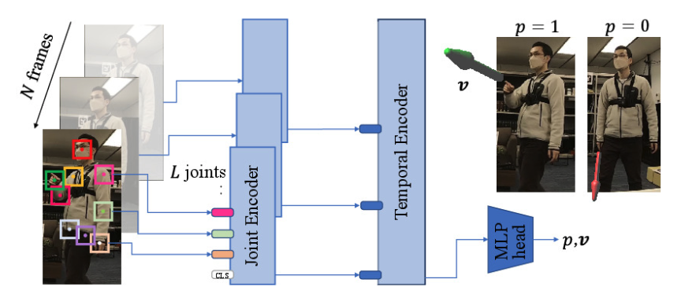

Slide 35
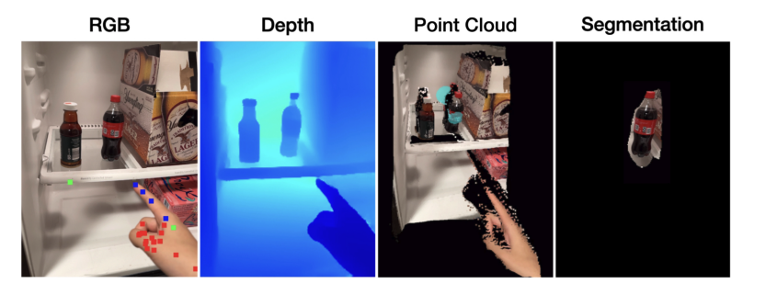

Slide 36
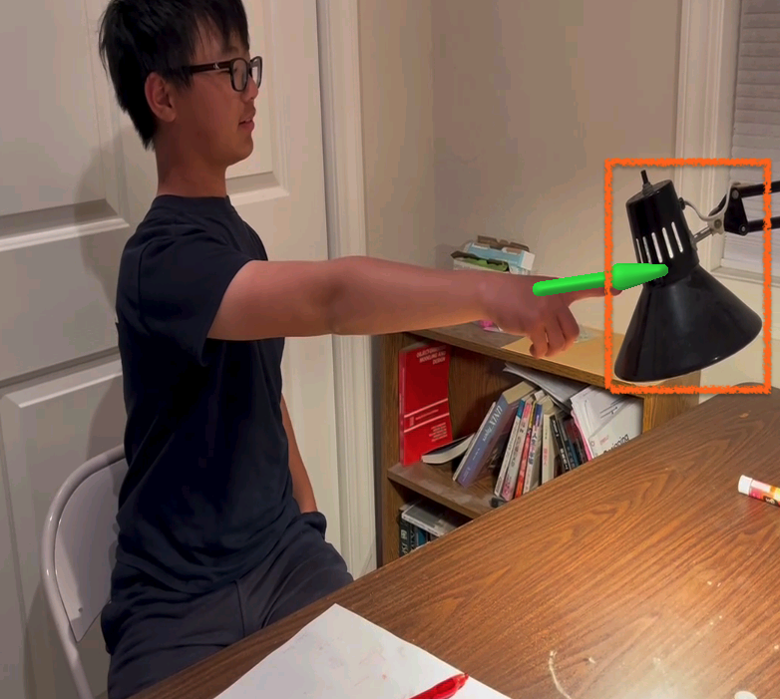

Slide 37
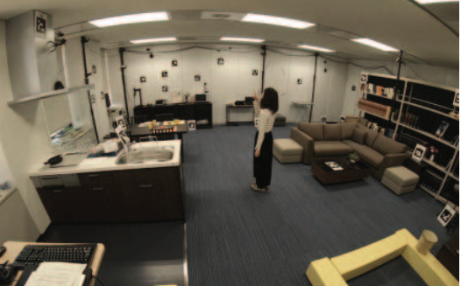

Slide 38
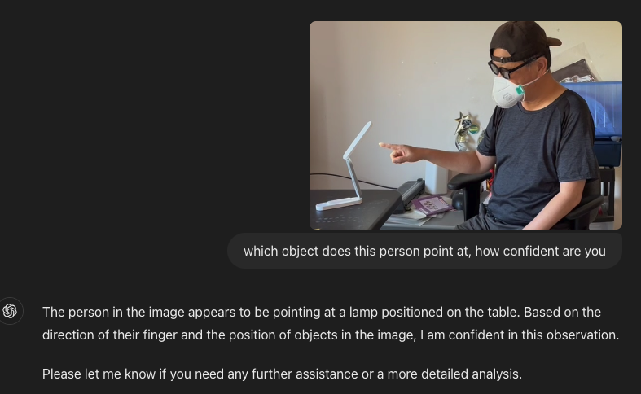

Slide 39
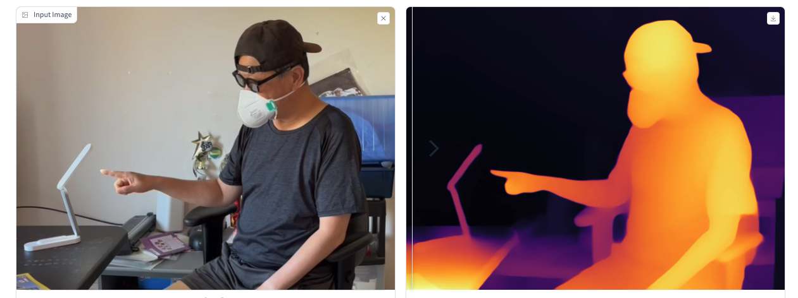

Slide 40
Pipeline
Deepoint Transformer
3D pointing direction vector
Video/ images
Intersection computation (geometry based)
Class/label or none
3D point cloud object detection
3D object point cloud coordinates and class/label

Slide 41
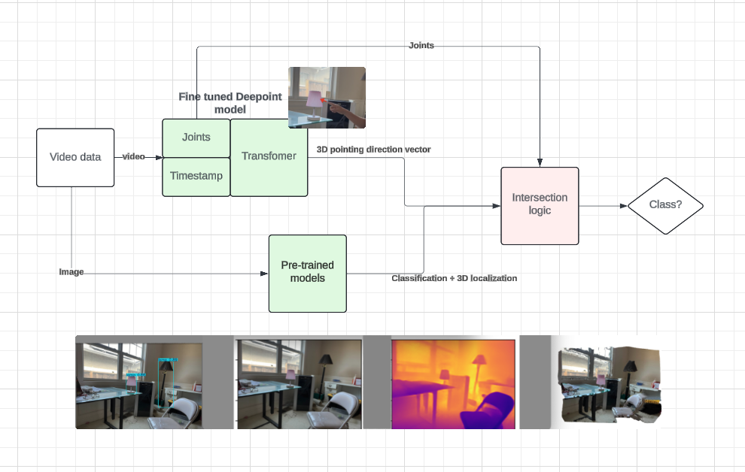

Slide 42
